Slide 1
Data Mining: Clustering
Tom Heskes

Slide 2
What is Cluster Analysis?
Finding groups of objects such that the objects in a group will be similar (or related) to one another and different from (or unrelated to) the objects in other groups
Inter-cluster distances are maximized
Intra-cluster distances are minimized

Slide 3
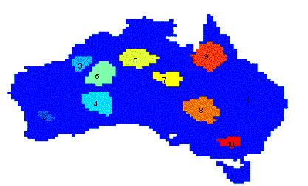
Applications of Cluster Analysis
Understanding
Group related documents for browsing, group genes and proteins that have similar functionality, or group stocks with similar price fluctuations
Summarization
Reduce the size of large data sets

Slide 4
What is not Cluster Analysis?
Supervised classification
Have class label information
Simple segmentation
Dividing students into different registration groups alphabetically, by last name
Results of a query
Groupings are a result of an external specification
Graph partitioning
Some mutual relevance and synergy, but areas are not identical

Slide 5
Notion of a Cluster can be Ambiguous
How many clusters?
Six Clusters
Two Clusters
Four Clusters

Slide 6
Types of Clusterings
A clustering is a set of clusters
Important distinction between hierarchical and partitional sets of clusters
Partitional Clustering
A division data objects into non-overlapping subsets (clusters) such that each data object is in exactly one subset
Hierarchical clustering
A set of nested clusters organized as a hierarchical tree

Slide 7
Partitional Clustering
Original Points
Partitional Clustering

Slide 8
Hierarchical Clustering
Traditional Hierarchical Clustering
Traditional Dendrogram
Hierarchical Clustering
Dendrogram

Slide 9
Other Distinctions Between Sets of Clusters
Exclusive versus non-exclusive
In non-exclusive clusterings, points may belong to multiple clusters.
Can represent multiple classes or ‘border’ points
Fuzzy versus non-fuzzy
In fuzzy clustering, a point belongs to every cluster with some weight between 0 and 1
Weights must sum to 1
Probabilistic clustering has similar characteristics
Partial versus complete
In some cases, we only want to cluster some of the data
Heterogeneous versus homogeneous
Cluster of widely different sizes, shapes, and densities

Slide 10
Types of Clusters
Well-separated clusters
Center-based clusters
Contiguous clusters
Density-based clusters
Property or Conceptual
Based upon an objective function

Slide 11
Types of Clusters: Well-Separated
A well-separated cluster is a set of points such that any point in a cluster is closer (or more similar) to every other point in the cluster than to any point not in the cluster
3 well-separated clusters

Slide 12
Types of Clusters: Center-Based
A center-based cluster is a set of objects such that an object in a cluster is closer (more similar) to the “center” of a cluster, than to the center of any other cluster
The center of a cluster is often a centroid, the average of all the points in the cluster, or a medoid, the most “representative” point of a cluster
4 center-based clusters

Slide 13
Types of Clusters: Contiguity-Based
A contiguous (nearest-neighbor, transitive) cluster is a set of points such that a point in a cluster is closer (or more similar) to one or more other points in the cluster than to any point not in the cluster
8 contiguous clusters

Slide 14
Types of Clusters: Density-Based
A density-based cluster is a dense region of points, which is separated by low-density regions, from other regions of high density
Used when the clusters are irregular or intertwined, and when noise and outliers are present
6 density-based clusters

Slide 15
Types of Clusters: Conceptual Clusters
A conceptual (shared-property) cluster contains points that jointly share some common property or represent a particular concept
2 overlapping circles

Slide 16
Types of Clusters: Based upon an Objective Function (1)
Many objective functions that define the “goodness” of a clustering
Specific algorithms for optimizing such an objective functions
Finding the optimal solution often requires enumerating all possible ways of dividing the points into clusters (NP Hard)
Can have global or local objectives
Hierarchical clustering algorithms typically have local objectives
Partitional algorithms typically have global objectives

Slide 17
Types of Clusters: Based upon an Objective Function (2)
A variation of the global objective function approach is to fit the data to a parameterized statistical model
Parameters for the model are determined from the data.
Mixture models assume that the data is a ‘mixture' of a number of statistical distributions.
Alternative approach is to map the clustering problem to a different domain and solve a related problem in that domain
E.g., proximity matrix defines a weighted graph, where the nodes are the points being clustered, and the weighted edges represent the proximities between points
Clustering is equivalent to breaking the graph into connected components, one for each cluster: minimum spanning tree algorithm

Slide 18
Characteristics of the Input Data Are Important
Type of proximity or density measure
This is a derived measure, but central to clustering
Sparseness
Dictates type of similarity
Adds to efficiency
Attribute type
Dictates type of similarity
Type of Distribution
Dictates type of similarity
Other characteristics, e.g., autocorrelation

Slide 19
Clustering Algorithms
K-means and its variants
Hierarchical clustering
Density-based clustering

Slide 20
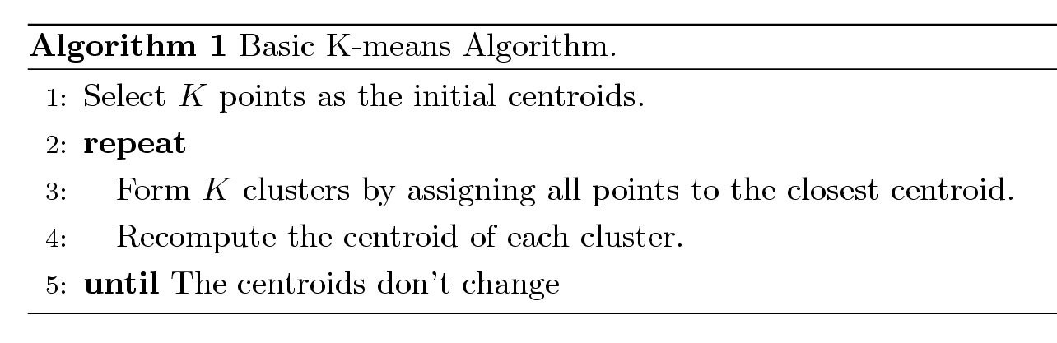
K-means Clustering
Partitional clustering approach
Each cluster is associated with a centroid (center point)
Each point is assigned to the cluster with the closest centroid
Number of clusters, K, must be specified
The basic algorithm is very simple

Slide 21
K-means Clustering – Details
Initial centroids are often chosen randomly
Clusters produced vary from one run to another
The centroid is (typically) the mean of the points in the cluster
‘Closeness’ is measured by Euclidean distance, cosine similarity, correlation, etc.

Slide 22
K-means Clustering – Implementation
MATLAB: % X: data matrix, K: number of clusters [idx,C] = kmeans(X,K)
Python: from sklearn.cluster import Kmeans kmeans = KMeans(n_clusters=K, random_state=0).fit(X)

Slide 23
K-means Clustering – Convergence and Complexity
K-means will converge for common similarity measures
Most of the convergence happens in the first few iterations
Often the stopping condition is changed to ‘Until relatively few points change clusters’
Complexity is O(n K I d)
n = number of points, K = number of clusters, I = number of iterations, d = number of attributes

Slide 24
Two different K-means Clusterings
Original Points
Optimal Clustering
Sub-optimal Clustering

Slide 25
Importance of Choosing Initial Centroids (1)

Slide 26
Importance of Choosing Initial Centroids (2)

Slide 27
Evaluating K-means Clusters
Most common measure is Sum of Squared Error (SSE)
For each point, the error is the distance to the nearest cluster
To get SSE, we square these errors and sum them:
x is a data point in cluster C_{i} and m_{i} is the representative point for cluster C_{i}
Given two clusterings, the one with the smallest error is “better”
One easy way to reduce SSE is to increase K, the number of clusters, so it typically only makes sense to compare SSE’s for clusterings with the same K

Slide 28
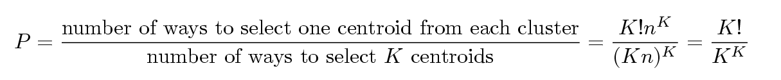
Problems with Selecting Initial Points
If there are K ‘real’ clusters then the chance of selecting one centroid from each cluster is small
Chance is relatively small when K is large
If clusters are the same size, n, then
For example, if K = 10, then probability = 10!/10¹⁰ = 0.00036
Sometimes the initial centroids will readjust themselves in ‘right’ way, and sometimes they don’t...

Slide 29
10 Clusters Example (1)
Starting with two initial centroids in one cluster of each pair of clusters

Slide 30
10 Clusters Example (2)
Starting with some pairs of clusters having three initial centroids, others only one

Slide 31
Solutions to Initial Centroids Problem
Multiple runs
Helps, but probability is not on your side
Sample and use hierarchical clustering to determine initial centroids
Select more than K initial centroids and then select among these initial centroids
Select most widely separated
Postprocessing
Bisecting K-means
Not as susceptible to initialization issues

Slide 32
Handling Empty Clusters
Basic K-means algorithm can yield empty clusters
Idea: set the cluster center of an empty cluster equal to one of the data points and continue updating
Several strategies
Choose the data point that contributes most to SSE
Choose a data point from the cluster with the highest SSE
If there are several empty clusters, the above can be repeated several times

Slide 33
Updating Centers Incrementally
In the basic K-means algorithm, centroids are updated after all points are assigned to a centroid
An alternative is to update the centroids after each assignment (incremental approach)
Each assignment updates zero or two centroids
More expensive
Introduces an order dependency
Never get an empty cluster

Slide 34
Pre-processing and Post-processing
Pre-processing
Normalize the data
Eliminate outliers
Post-processing
Eliminate small clusters that may represent outliers
Split ‘loose’ clusters, i.e., clusters with relatively high SSE
Merge clusters that are ‘close’ and that have relatively low SSE
Can use these steps during the clustering process (done in an algorithm called ISODATA)

Slide 35
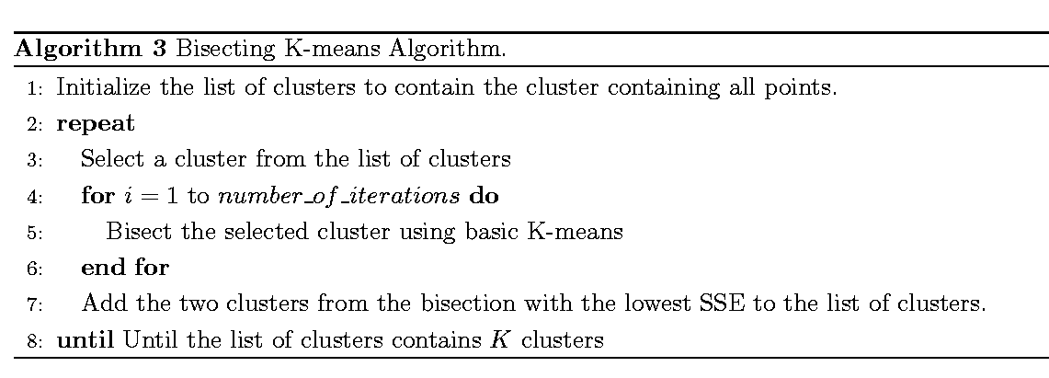
Bisecting K-means
Variant of K-means that can produce a partitional or a hierarchical clustering

Slide 36
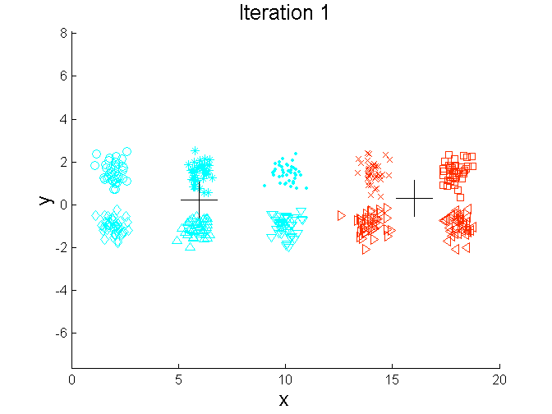
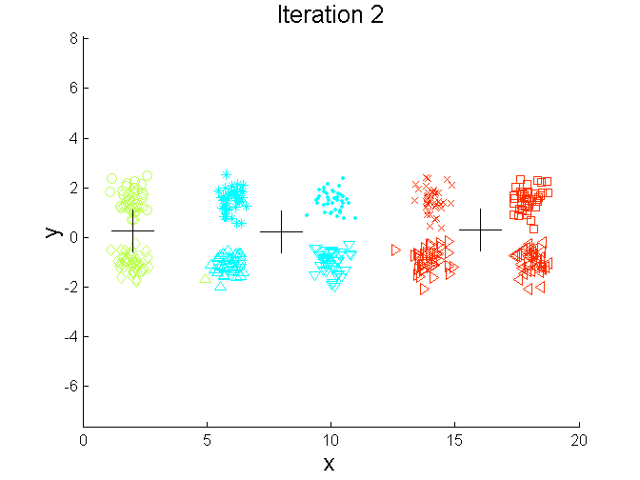
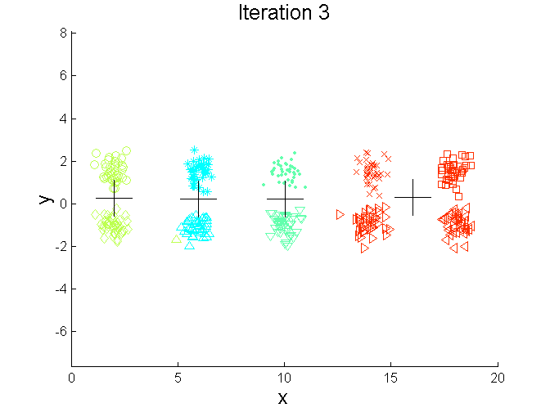
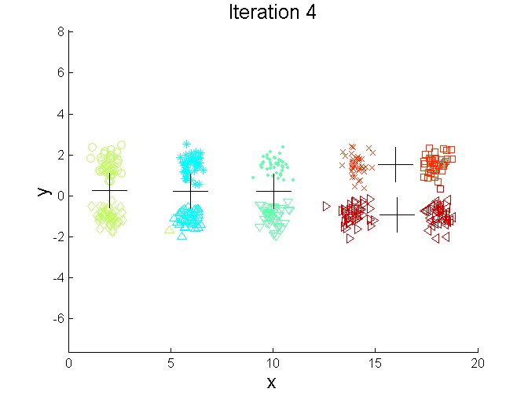
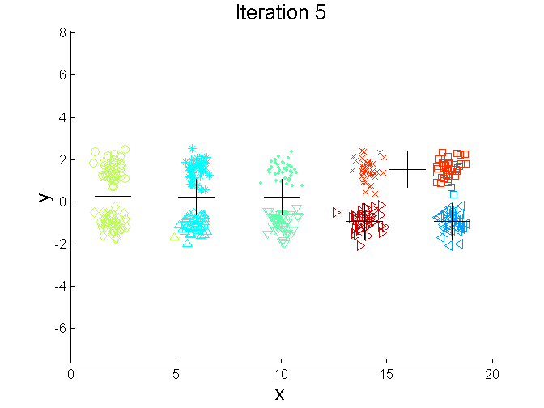
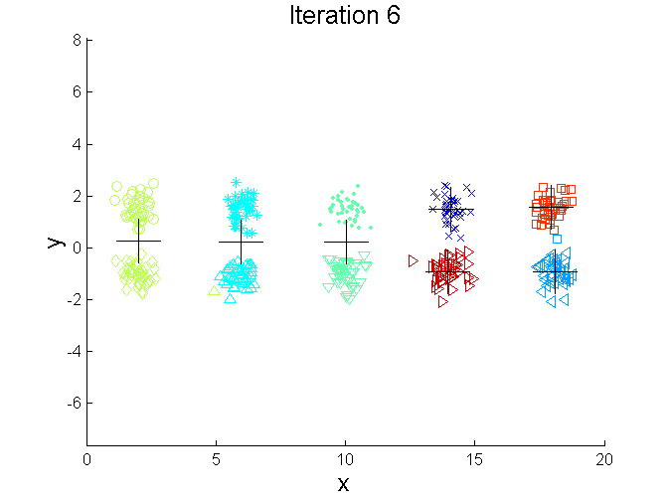
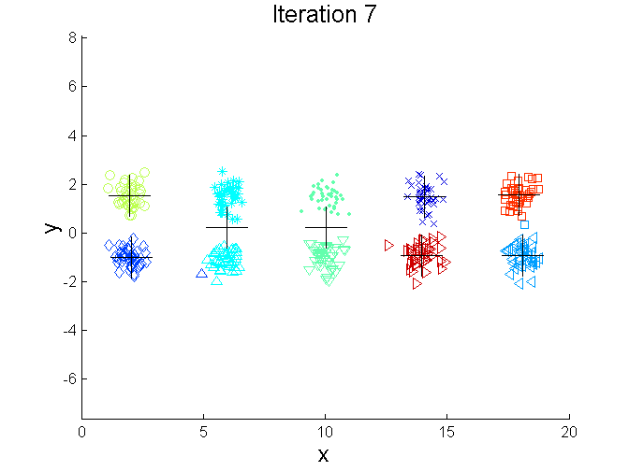
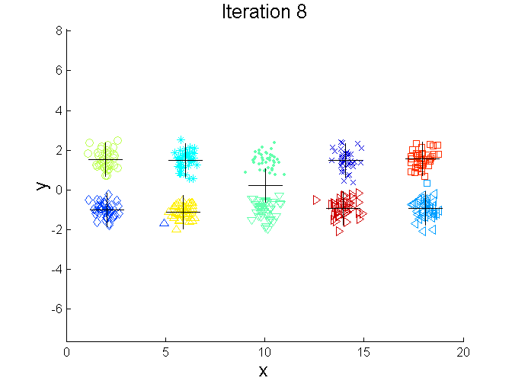
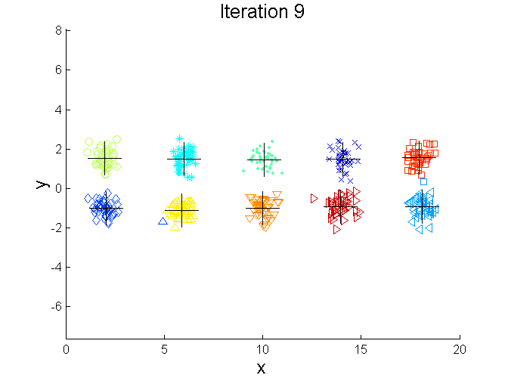
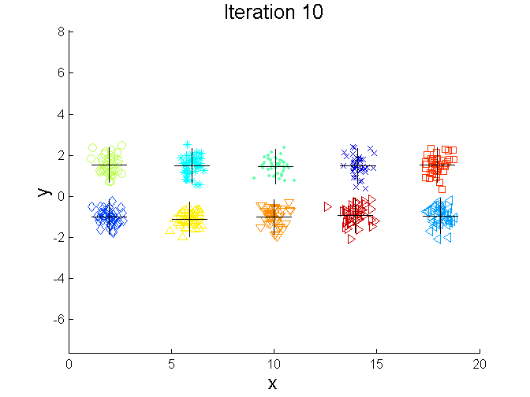
Bisecting K-means Example

Slide 37
Limitations of K-means
K-means has problems when clusters are of differing
sizes
densities
non-globular shapes
K-means has problems when the data contains outliers

Slide 38
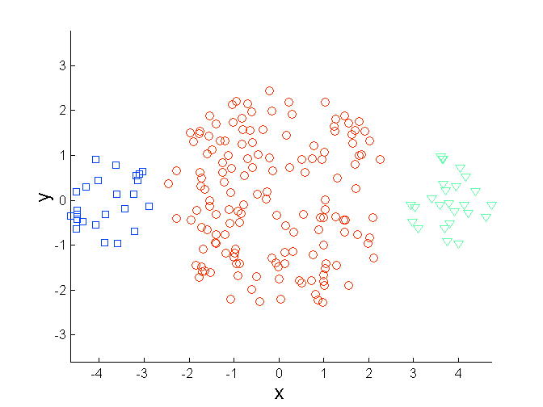
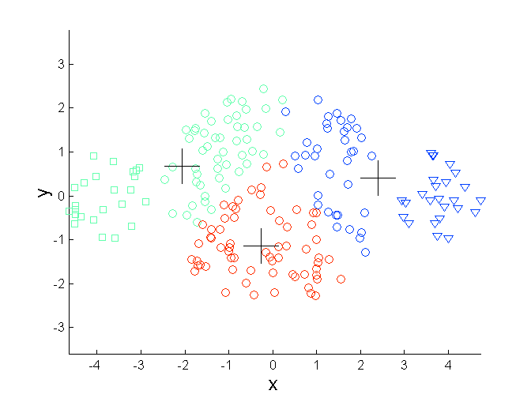
Limitations of K-means: Differing Sizes
Original Points
K-means (3 Clusters)

Slide 39
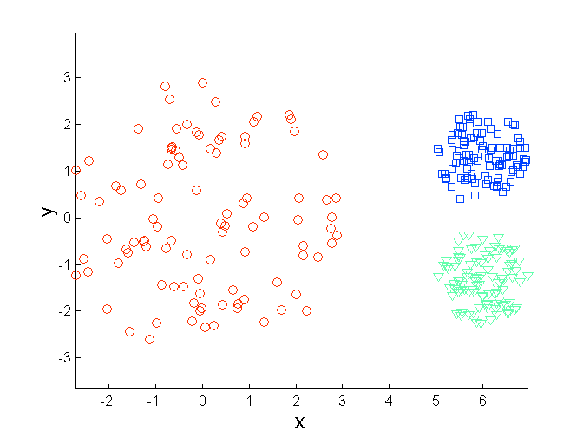
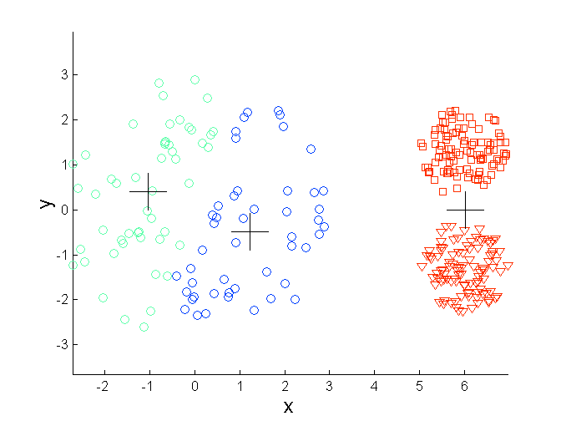
Limitations of K-means: Differing Density
Original Points
K-means (3 Clusters)

Slide 40
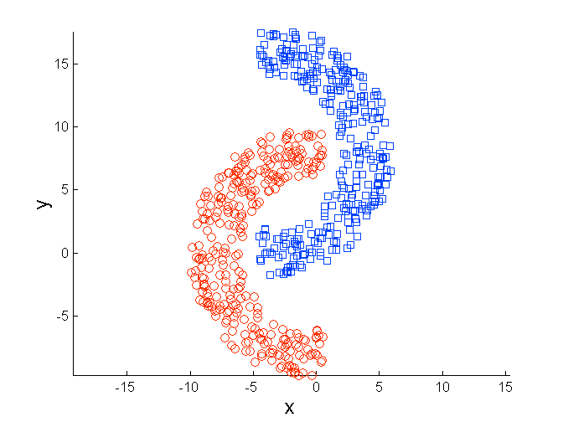
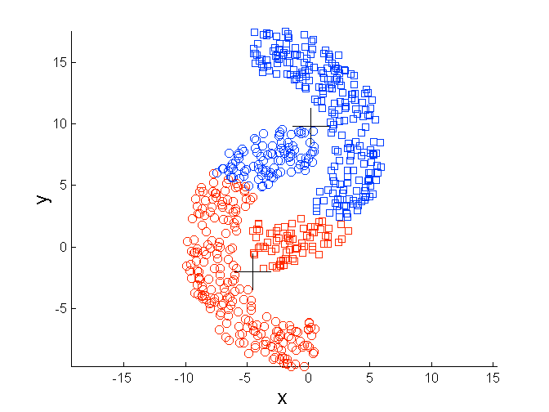
Limitations of K-means: Non-globular Shapes
Original Points
K-means (2 Clusters)

Slide 41
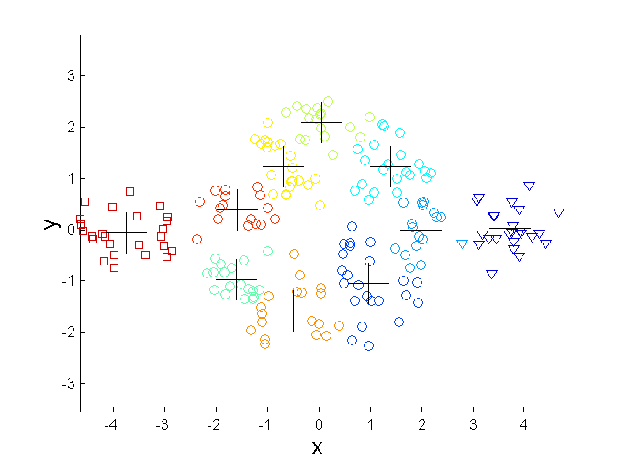
Overcoming K-means Limitations (1)
One solution is to use many clusters: find parts of clusters, but then you need to put these together
Original Points K-means Clusters

Slide 42
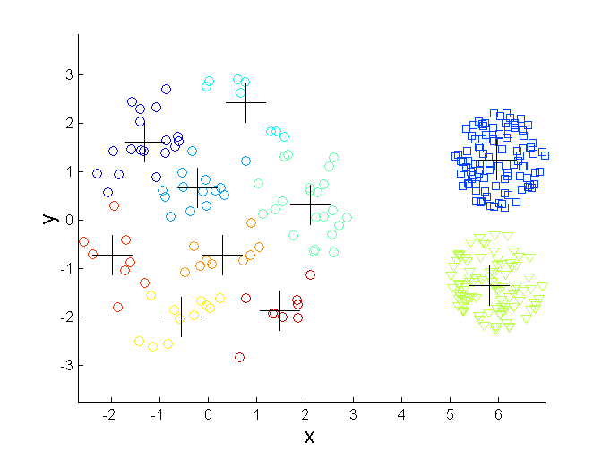
Overcoming K-means Limitations
Original Points K-means Clusters

Slide 43
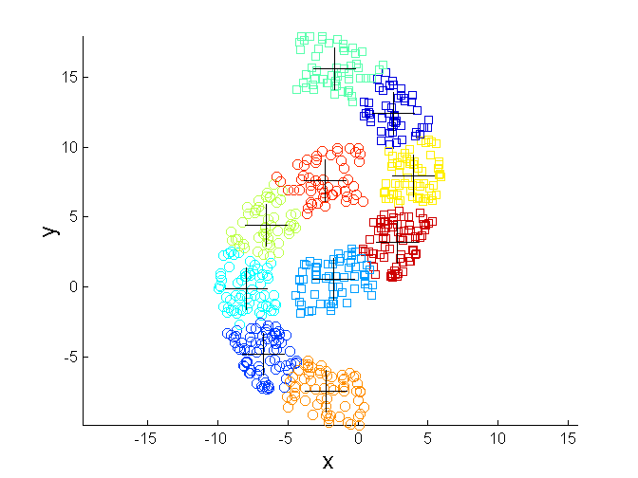
Overcoming K-means Limitations
Original Points K-means Clusters

Slide 44
Hierarchical Clustering
Produces a set of nested clusters organized as a hierarchical tree
Can be visualized as a dendrogram
A tree like diagram that records the sequences of merges or splits

Slide 45
Strengths of Hierarchical Clustering
Do not have to assume any particular number of clusters
Any desired number of clusters can be obtained by ‘cutting’ the dendogram at the proper level
They may correspond to meaningful taxonomies
Example in biological sciences (e.g., animal kingdom, phylogeny reconstruction, …)

Slide 46
Hierarchical Clustering
Agglomerative:
Start with the points as individual clusters
At each step, merge the closest pair of clusters until only one cluster (or k clusters) left
Divisive:
Start with one, all-inclusive cluster
At each step, split a cluster until each cluster contains a point (or there are k clusters)
Traditional hierarchical algorithms use a similarity or distance matrix
Merge or split one cluster at a time

Slide 47
Agglomerative Clustering Algorithm
Basic algorithm is straightforward:
Compute the proximity matrix
Let each data point be a cluster
Repeat
Merge the two closest clusters
Update the proximity matrix
Until only a single cluster remains
Different approaches to defining the distance between two clusters in step 5 distinguish the different algorithms

Slide 48
Starting Situation
Start with clusters of individual points and a proximity matrix
 | p1 | p2 | p3 | p4 | p5 | ...
p1
p2
p3
p4
p5
...
Proximity Matrix

Slide 49
Intermediate Situation (1)
 | C1 | C2 | C3 | C4 | C5
C1
C2
C3
C4
C5
After some merging steps we have some clusters
C3
C4
Proximity Matrix
C1
C2
C5

Slide 50
Intermediate Situation (2)
 | C1 | C2 | C3 | C4 | C5
C1
C2
C3
C4
C5
We want to merge the two closest clusters (C2 and C5) and update the proximity matrix
C3
C4
Proximity Matrix
C1
C2
C5

Slide 51
After merging
 | C1 | C2 U C5 | C3 | C4
C1 |  | ?
C2 U C5 | ? |  | ? | ?
C3 |  | ?
C4 |  | ?
The question is “How do we update the proximity matrix?”
C3
Proximity Matrix
C4
C1
C2 U C5

Slide 52
How to define cluster similarity
 | p1 | p2 | p3 | p4 | p5 | ...
p1
p2
p3
p4
p5
...
Similarity?
Min
Max
Group average
Distance between centroids
Other methods driven by an objective function
Ward’s method uses squared error
Proximity Matrix

Slide 53
How to define cluster similarity
 | p1 | p2 | p3 | p4 | p5 | ...
p1
p2
p3
p4
p5
...
Min
Max
Group average
Distance between centroids
Other methods driven by an objective function
Ward’s method uses squared error
Proximity Matrix

Slide 54
How to define cluster similarity
 | p1 | p2 | p3 | p4 | p5 | ...
p1
p2
p3
p4
p5
...
Min
Max
Group average
Distance between centroids
Other methods driven by an objective function
Ward’s method uses squared error
Proximity Matrix

Slide 55
How to define cluster similarity
 | p1 | p2 | p3 | p4 | p5 | ...
p1
p2
p3
p4
p5
...
Min
Max
Group average
Distance between centroids
Other methods driven by an objective function
Ward’s method uses squared error
Proximity Matrix

Slide 56
How to define cluster similarity
 | p1 | p2 | p3 | p4 | p5 | ...
p1
p2
p3
p4
p5
...
×
×
Min
Max
Group average
Distance between centroids
Other methods driven by an objective function
Ward’s method uses squared error
Proximity Matrix

Slide 57
Cluster Similarity: Min or Single Link
Similarity of two clusters is based on the two most similar (closest) points in the different clusters
Determined by one pair of points, i.e., by one link in the proximity graph
 | p1 | p2 | p3 | p4 | p5
p1 | 1.00 | 0.90 | 0.10 | 0.65 | 0.20
p2 | 0.90 | 1.00 | 0.70 | 0.60 | 0.50
p3 | 0.10 | 0.70 | 1.00 | 0.40 | 0.30
p4 | 0.65 | 0.60 | 0.40 | 1.00 | 0.80
p5 | 0.20 | 0.50 | 0.30 | 0.80 | 1.00
1
2
3
4
5

Slide 58
Hierarchical Clustering: Min
5
1
3
5
2
1
2
3
6
4
4
Dendrogram
Nested Clusters

Slide 59
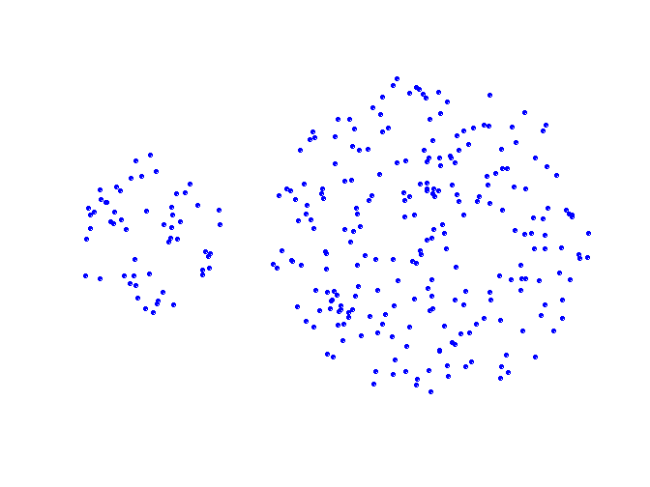
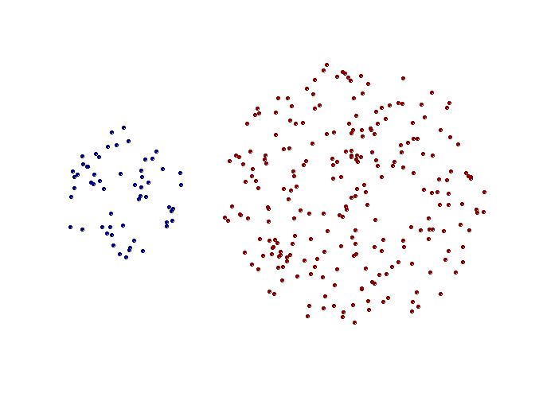
Strength of Min
Can handle non-spherical shapes
Original Points
Two Clusters

Slide 60
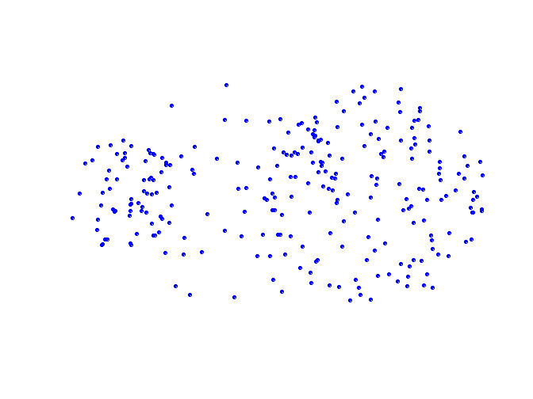
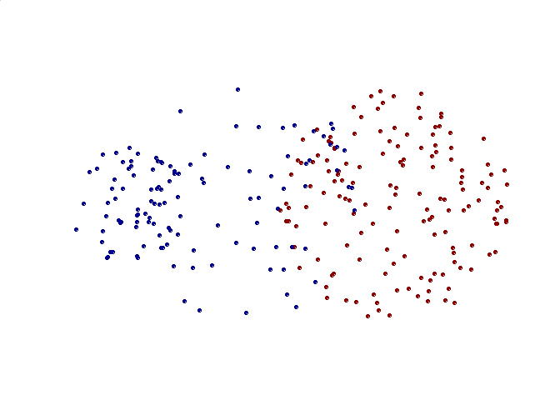
Limitations of Min
Sensitive to noise and outliers
Original Points
Two Clusters

Slide 61
Cluster Similarity: Max or Complete Linkage
Similarity of two clusters is based on the two least similar (most distant) points in the different clusters
Determined by all pairs of points in the two clusters
 | p1 | p2 | p3 | p4 | p5
p1 | 1.00 | 0.90 | 0.10 | 0.65 | 0.20
p2 | 0.90 | 1.00 | 0.70 | 0.60 | 0.50
p3 | 0.10 | 0.70 | 1.00 | 0.40 | 0.30
p4 | 0.65 | 0.60 | 0.40 | 1.00 | 0.80
p5 | 0.20 | 0.50 | 0.30 | 0.80 | 1.00
1
2
3
4
5

Slide 62
Hierarchical Clustering: Max
4
1
2
5
5
2
3
6
3
1
4
Nested Clusters
Dendrogram

Slide 63
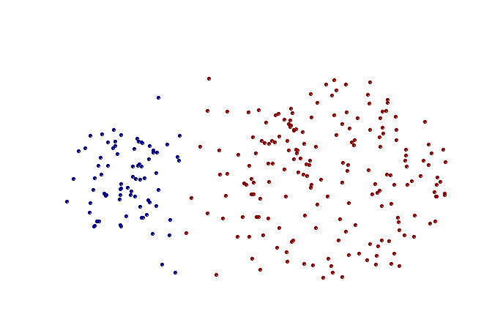
Strength of Max
Less susceptible to noise and outliers
Original Points
Two Clusters

Slide 64
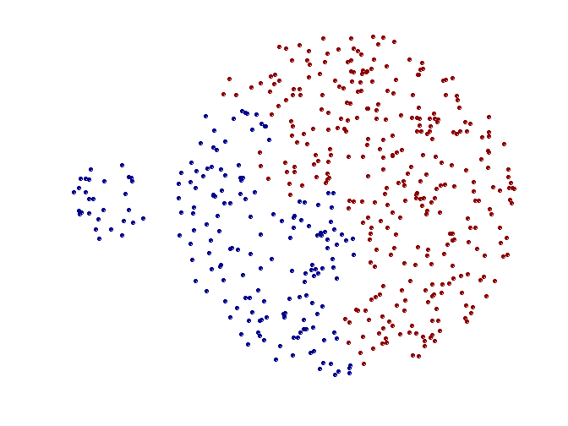
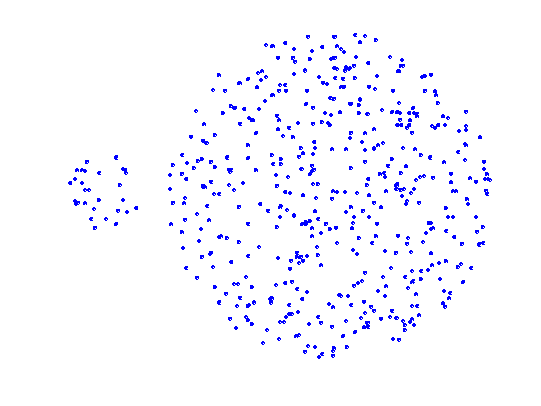
Limitations of Max
Tends to break large clusters
Biased towards globular clusters
Original Points
Two Clusters

Slide 65
Cluster Similarity: Group Average
Proximity of two clusters is the average of pairwise proximity between points in the two clusters:
 | p1 | p2 | p3 | p4 | p5
p1 | 1.00 | 0.90 | 0.10 | 0.65 | 0.20
p2 | 0.90 | 1.00 | 0.70 | 0.60 | 0.50
p3 | 0.10 | 0.70 | 1.00 | 0.40 | 0.30
p4 | 0.65 | 0.60 | 0.40 | 1.00 | 0.80
p5 | 0.20 | 0.50 | 0.30 | 0.80 | 1.00
1
2
3
4
5
1
2
3
4
5

Slide 66
Hierarchical Clustering: Group Average
5
4
1
2
5
2
3
6
1
4
3
Nested Clusters
Dendrogram

Slide 67
Hierarchical Clustering: Group Average
Compromise between Single and Complete Linkage
Strengths
Less susceptible to noise and outliers
Limitations
Biased towards globular clusters

Slide 68
Cluster Similarity: Ward’s Method
Similarity of two clusters is based on the increase in squared error when two clusters are merged
Similar to group average if distance between points is distance squared
Less susceptible to noise and outliers
Biased towards globular clusters
Hierarchical analogue of K-means
Can be used to initialize K-means

Slide 69
Hierarchical Clustering: Comparison
5
4
1
1
3
2
5
5
5
2
2
1
Max
2
Min
3
6
3
6
3
1
4
4
4
5
1
5
4
1
2
Ward’s Method
2
5
2
5
2
3
6
3
6
3
1
Group Average
4
1
4
4
3

Slide 70
Hierarchical Clustering: Time and Space Requirements
O(N²) space since it uses the proximity matrix
N is the number of points
O(N³) time in many cases
There are N steps and at each step the size, N², proximity matrix must be updated and searched
Complexity can be reduced to O(N² log(N) ) time for some approaches

Slide 71
Hierarchical Clustering: Problems and Limitations
Once a decision is made to combine two clusters, it cannot be undone
No objective function is directly minimized
Different schemes have problems with one or more of the following:
Sensitivity to noise and outliers
Difficulty handling different sized clusters and convex shapes
Breaking large clusters

Slide 72
Hierarchical Clustering in MATLAB
% load iris data set; gives input in meas and % cluster labels in species
load fisheriris
% Ward’s method with Euclidean distance as metric
Z = linkage(meas,'ward','euclidean');
dendrogram(Z) % plots dendrogram
c = cluster(Z,'maxclust',4); % choose 4 clusters
crosstab(c,species) % confusion matrix

Slide 73
Hierarchical Clustering in Python (1)
from sklearn import datasets
from sklearn.metrics import confusion_matrix as confuse
from matplotlib import pyplot as plt
from scipy.cluster.hierarchy import dendrogram, linkage, fcluster
# load iris data; measurements accessed with key 'data'
# print iris.keys() for all objects in the set
iris = datasets.load_iris()
data, targets = iris['data'], iris['targets']
# Ward's method automatically uses Euclidean as metric
Z = linkage(data, 'ward')

Slide 74
Hierarchical Clustering in Python (2)
# Plotting results
plt.figure()
dendrogram(Z)
plt.figure()
clusters = fcluster(Z, 4, 'maxclust') # Find 4 clusters
plt.imshow(confuse(targets, clusters), cmap='Blues', interpolation='nearest')
plt.show()

Slide 75
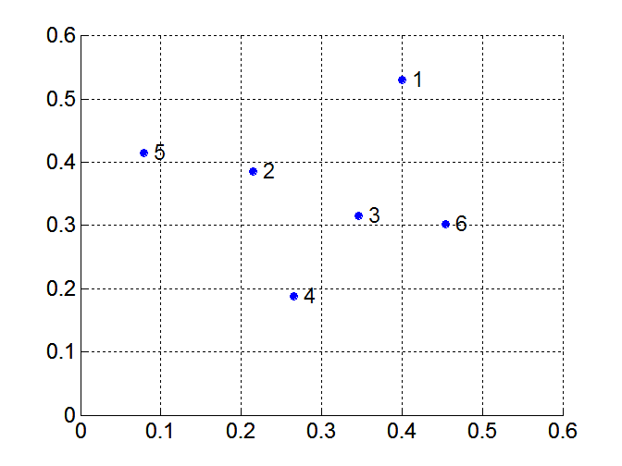
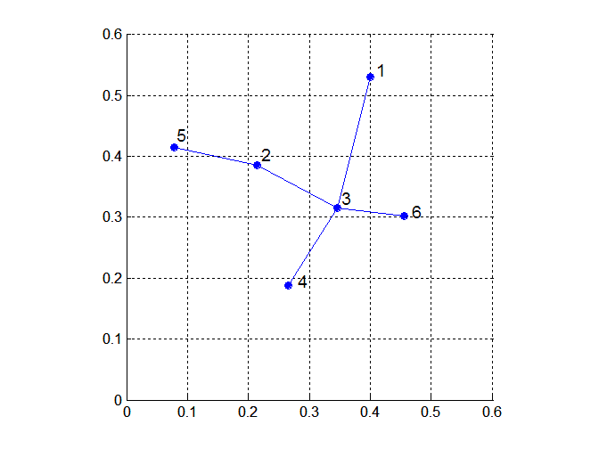
MST: Divisive Hierarchical Clustering (1)
Build MST (Minimum Spanning Tree)
Start with a tree that consists of any point
In successive steps, look for the closest pair of points (p,q) such that one point (p) is in the current tree but the other (q) is not
Add q to the tree and put an edge between p and q

Slide 76
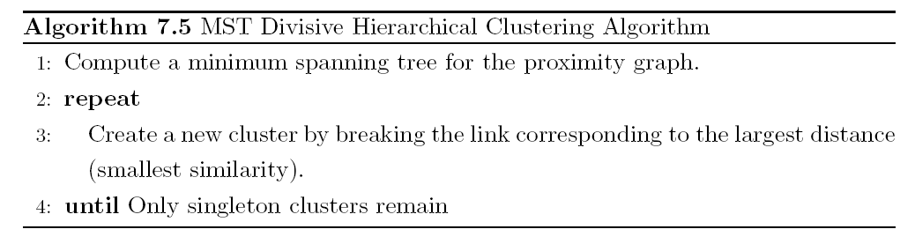
MST: Divisive Hierarchical Clustering (2)
Use MST for constructing hierarchy of clusters

Slide 77
DBSCAN
DBSCAN is a density-based algorithm
Density = number of points within a specified radius (Eps)
A point is a core point if it has more than a specified number of points (MinPts) within Eps
These are points that are at the interior of a cluster
A border point has fewer than MinPts within Eps, but is in the neighborhood of a core point
A noise point is any point that is not a core point or a border point.

Slide 78
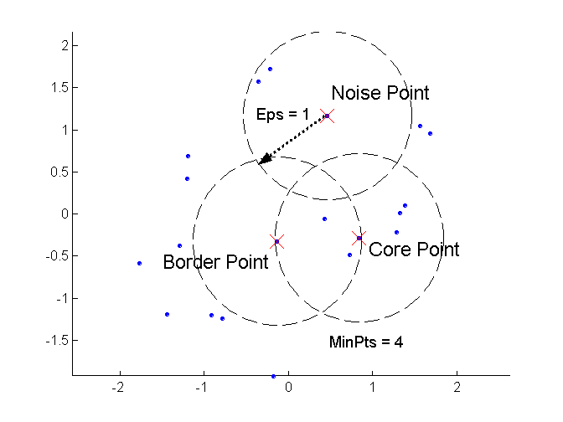
DBSCAN: Core, Border, and Noise Points

Slide 79
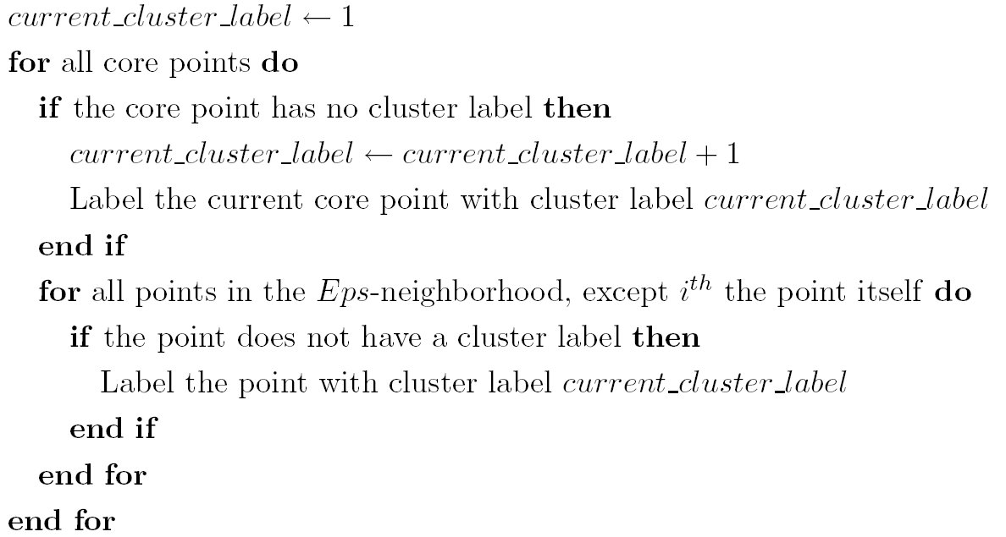
DBSCAN Algorithm
Eliminate noise points
Perform clustering on the remaining points
0

Slide 80
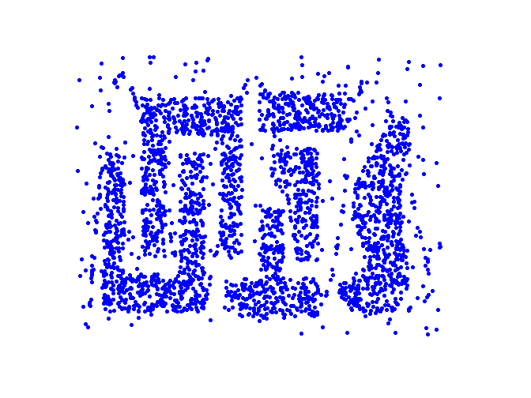
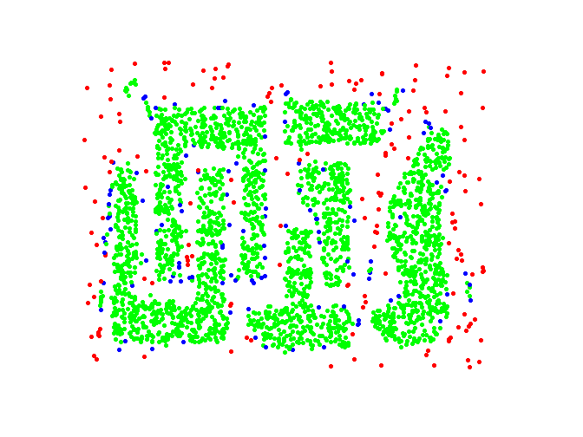
DBSCAN: Core, Border and Noise Points
Eps = 10, MinPts = 4
Original Points
Point types: core, border and noise

Slide 81
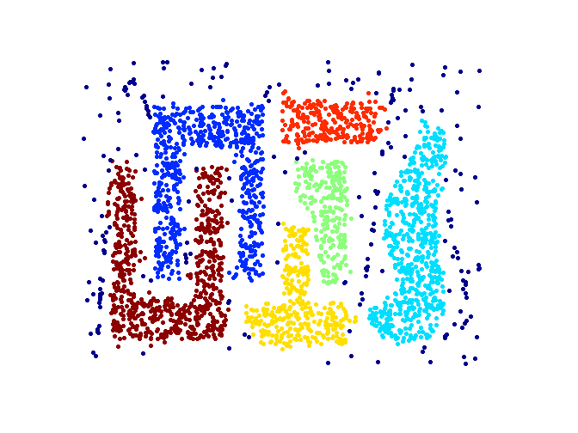
When DBSCAN Works Well
Resistant to Noise
Can handle clusters of different shapes and sizes
Original Points
Clusters

Slide 82
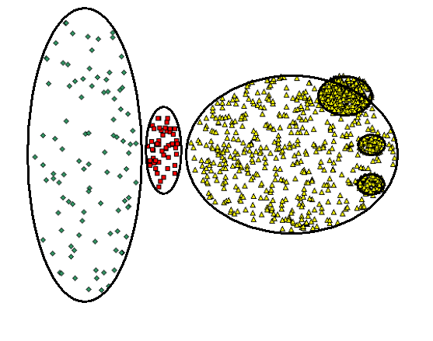
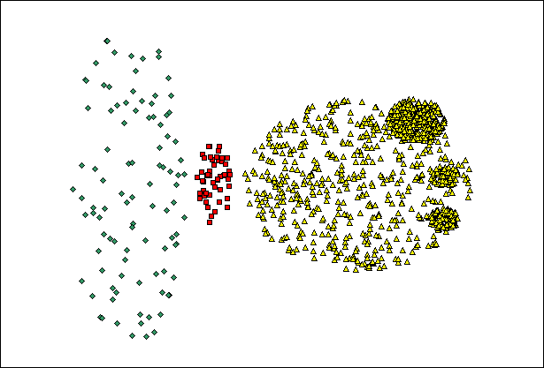
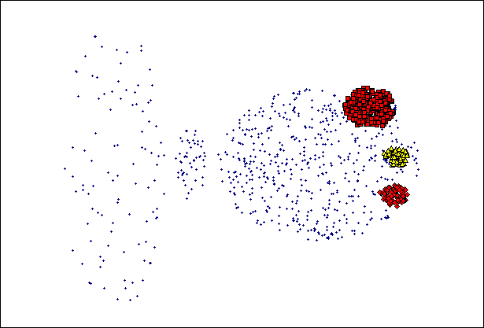
When DBSCAN Does NOT Work Well
Varying densities
High-dimensional data
(MinPts=4, Eps=9.75
Original Points
(MinPts=4, Eps=9.92

Slide 83
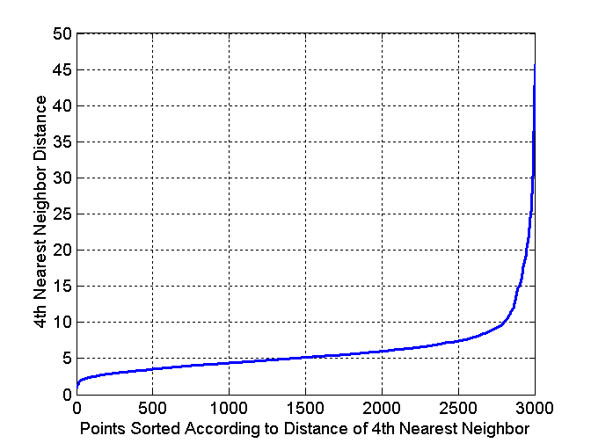
DBSCAN: Determining EPS and MinPts
Idea is that for points in a cluster, their k^{th} nearest neighbors, with k equal to MinPts, are at roughly the same distance
Noise points have the k^{th} nearest neighbor at farther distance
So, plot sorted distance of every point to its k^{th} nearest neighbor and look for sharp increase
In this example: choose Eps ≈10

Slide 84
Cluster Validity
For supervised classification we have a variety of measures to evaluate how good our model is
Accuracy, precision, recall, area under the curve, ...
For cluster analysis, the analogous question is how to evaluate the “goodness” of the resulting clusters?
But “clusters are in the eye of the beholder”!
Then why do we want to evaluate them?
To avoid finding patterns in noise
To compare clustering algorithms
To compare two sets of clusters
To compare two clusters

Slide 85
Clusters found in Random Data
Random Points
DBSCAN
K-means
Complete Link

Slide 86
Different Aspects of Cluster Validation
Determining the clustering tendency of a set of data, i.e., distinguishing whether non-random structure actually exists in the data
Comparing the results of a cluster analysis to externally known results, e.g., to externally given class labels
Evaluating how well the results of a cluster analysis fit the data without reference to external information
Comparing the results of two different sets of cluster analyses to determine which is better
Determining the ‘correct’ number of clusters
For 2, 3, and 4, we can further distinguish whether we want to evaluate the entire clustering or just individual clusters.

Slide 87
Measures of Cluster Validity
Numerical measures that are applied to judge various aspects of cluster validity, are classified into the following three types
External Index: Used to measure the extent to which cluster labels match externally supplied class labels; example: entropy
Internal Index: Used to measure the goodness of a clustering structure without respect to external information; example: sum of squared errors (SSE)
Relative Index: Used to compare two different clusterings or clusters.
Often an external or internal index is used for this function, e.g., SSE or entropy

Slide 88
Measuring Cluster Validity Via Correlation
Two matrices
Proximity Matrix (e.g., used as input to the clustering algorithm)
“Incidence” Matrix (computed from the clustering result)
Incidence matrix:
One row and one column for each data point
An entry is 1 if the associated pair of points belong to the same cluster
An entry is 0 if the associated pair of points belongs to different clusters
Compute the correlation between the two matrices
Since the matrices are symmetric, only the correlation between n (n-1)/2 entries needs to be calculated
High correlation (in absolute sense) indicates that points that belong to the same cluster are close to each other
Not a good measure for some density or contiguity based clusters

Slide 89
Measuring Cluster Validity Via Correlation
Correlation of incidence and proximity matrices for the K-means clusterings of the following two data sets
Correlation = -0.9235
Correlation = -0.5810

Slide 90
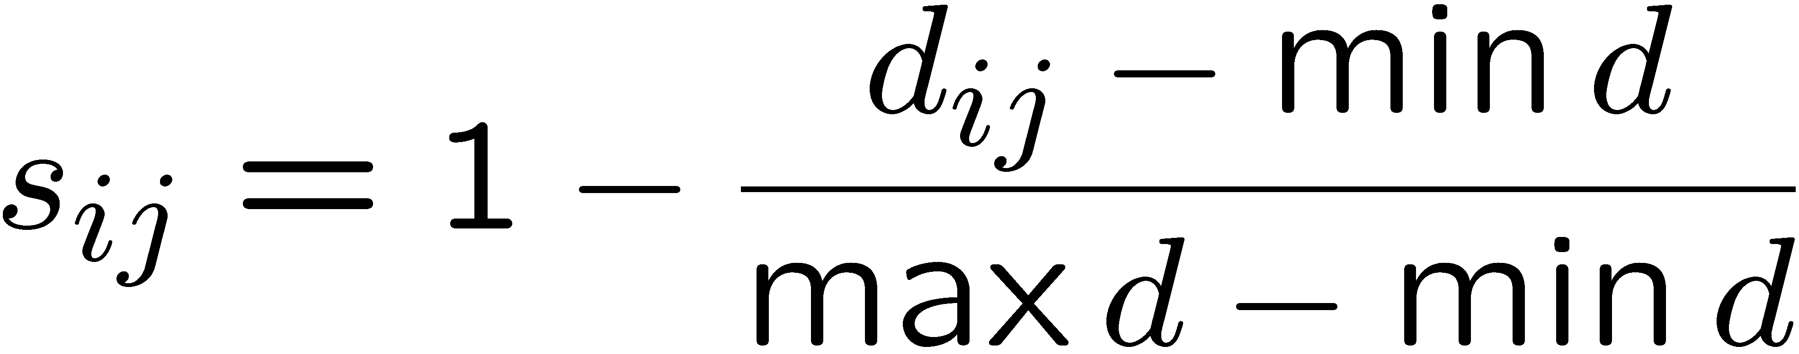
Using Similarity Matrix for Cluster Validation (1)
Order the similarity matrix with respect to cluster labels and inspect visually

Slide 91
Using Similarity Matrix for Cluster Validation (2)
Clusters in random data are not so crisp
K-means

Slide 92
Using Similarity Matrix for Cluster Validation (3)
Clusters in random data are not so crisp
Complete linkage

Slide 93
Using Similarity Matrix for Cluster Validation (4)
DBSCAN

Slide 94
Internal Measures: Sum of Squared Errors
Internal index: used to measure the goodness of a clustering structure without respect to external information
SSE can be used for comparing two clusterings (e.g., based on different numbers of clusters) or two clusters (small SSE: tight; high SSE: loose)
SSE
K

Slide 95
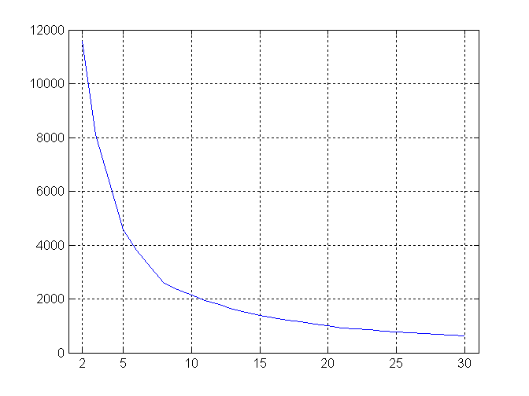
Internal Measures: Sum of Squared Errors
SSE curve for a more complicated data set and K-means
SSE
K

Slide 96
Framework for Cluster Validity
Need a framework to interpret any measure.
For example, if our measure of evaluation has the value 10, is that good, fair, or poor?
Statistics, in particular Monte Carlo sampling, provides a framework for cluster validity
The more “atypical” a clustering result is, the more likely it represents valid structure in the data
Can compare the values of an index obtained by clustering actual data with those obtained by clustering random data in the same range
If the value of the index is unlikely, then the cluster results are valid

Slide 97
Statistical Framework for SSE
Compare SSE of 0.005 against three clusters in random data
Histogram shows SSE of three clusters in 500 sets of random data points of size 100 distributed over the range [0.2,0.8] for x and y values

Slide 98
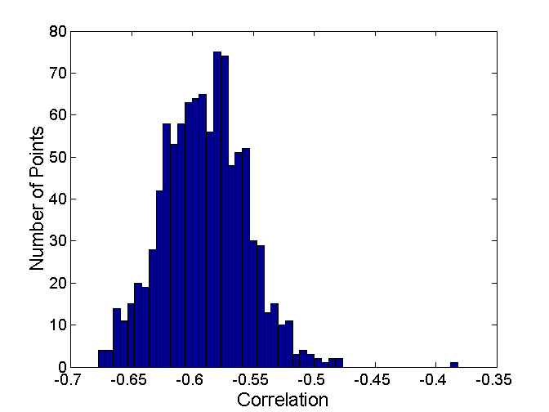
Statistical Framework for Correlation
Correlation of incidence and proximity matrices for the K-means clusterings of the following two data sets.
Correlation = -0.9235
Correlation = -0.5810

Slide 99
Internal Measures: Cohesion and Separation (1)
Cluster Cohesion measures how closely related are objects in a cluster, e.g., through the within cluster sum of squared errors:
Cluster Separation measure how distinct or well-separated a cluster is from other clusters, e.g., through the between cluster sum of squares: with |C_{i}| is the size of (i.e., number of data points belonging to) cluster i and m the overall mean of the data

Slide 100
Internal Measures: Cohesion and Separation (2)
It can be be shown that i.e., independent of the clustering
K=1 cluster: WSS = (3-1)²+(3-2)²+(4-3)²+(5-3)²=10; BSS = 0
K=2 clusters: WSS = (1.5-1)²+(2-1.5)²+(4.5-4)²+(5-4.5)² = 1; BSS = 2×(3-1.5)²+2× (4.5-3)² = 9
m
×
×
×
1
m₁
2
3
4
m₂
5

Slide 101
Internal Measures: Cohesion and Separation (3)
A proximity graph based approach can also be used for cohesion and separation
Cluster cohesion is the sum of the weight of all links within a cluster
Cluster separation is the sum of the weights between nodes in the cluster and nodes outside the cluster
cohesion
separation

Slide 102
Internal Measures: Silhouette Coefficient
The silhouette coefficient combines ideas of both cohesion and separation
Silhouette for data point i: s_{i} = (b_{i} – a_{i}) / max(a_{i},b_{i}), where
a_{i} = average distance of i to the points in the same cluster
b_{i} = min (average distance of i to points in another cluster), where the minimum is taken over all other clusters
Typically b_{i} ≥ a_{i} and then 0 ≤ s_{i} ≤ 1; the higher the better
Often also averaged over clusters and clusterings
a
b

Slide 103
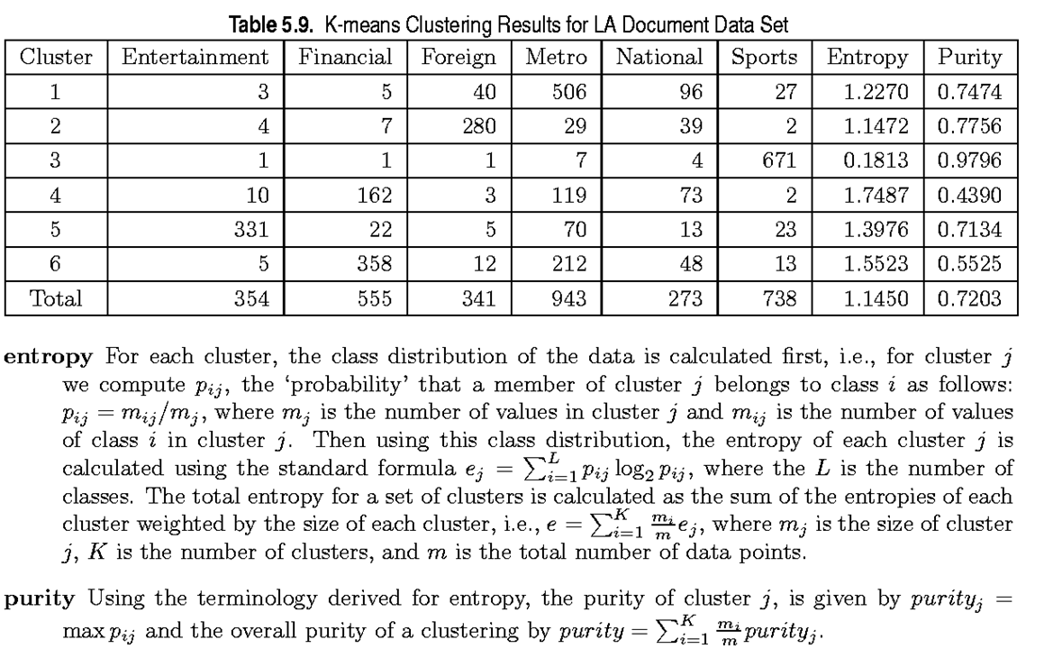
External Measures of Cluster Validity
When given labels (e.g., afterwards), there are better/easier ways to evaluate clusterings using so-called external measures
In the above clustering, which of the clusters performs best?

Slide 104
Purity and Entropy (1)
“Probability” that a member of cluster j belongs to class i: with N_{ij} the number of data points belonging to cluster j and class i
Purity of a cluster:
quality when you assign cluster j to the most likely corresponding class
Entropy of a cluster:
lower is better
Total entropy/purity of a clustering:

Slide 105
Purity and Entropy (2)

Slide 106

Final Comment on Cluster Validity
“The validation of clustering structures is the most difficult and frustrating part of cluster analysis. Without a strong effort in this direction, cluster analysis will remain a black art accessible only to those true believers who have experience and great courage.”
Algorithms for Clustering Data, Jain and Dubes

